Slide 1
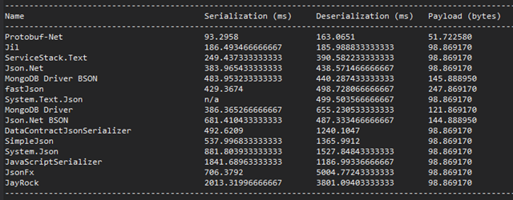
8 ways to improve ASP.NET Web API performance
http://blog.developers.ba/8-ways-improve-asp-net-web-api-performance/
1) Use fastest JSON serializer

Slide 2
2) Manual JSON serialize from DataReader
3) Use other formats if possible (protocol buffer, message pack)
4) Implement compression
5) Use caching

Slide 3
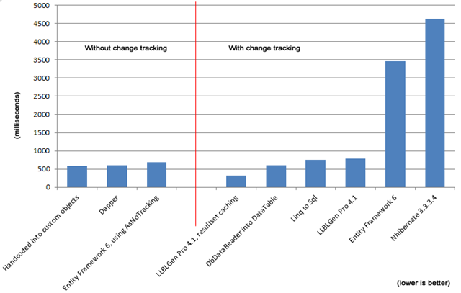
6) Use classic ADO.NET if possible

Slide 4
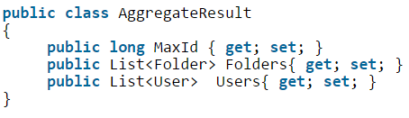
7) Implement async on methods of Web API
8) Return Multiple Resultsets and combined results

